Slide 2
Objectives
Understand and use data types: integer, real, char, string and Boolean
Declare and use constants and variables
Use input, output and assignment statements
Use arithmetic operators including MOD and DIV
Use string handling functions

Slide 3
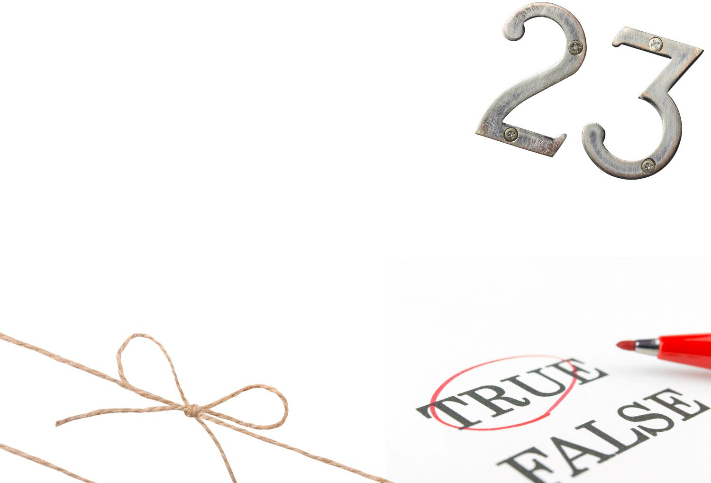

Starter
What is a data type?
How many can you name?
An arithmetic operator is a symbol that will perform an operation on numbers
+ is an example of an arithmetic operator that uses two numbers, e.g. 5 + 2
How many arithmetic operators can you name?

Slide 4
Starter
What is a data type? The kind of values that can be used in a data item
How many can you name? integer, real / float, char / character, string, Boolean
An arithmetic operator is a symbol that will perform an operation on numbers
+ is an example of an arithmetic operator that uses two numbers, e.g. 5 + 2
How many arithmetic operators can you name? +, -, *, /, ^, MOD, DIV

Slide 5
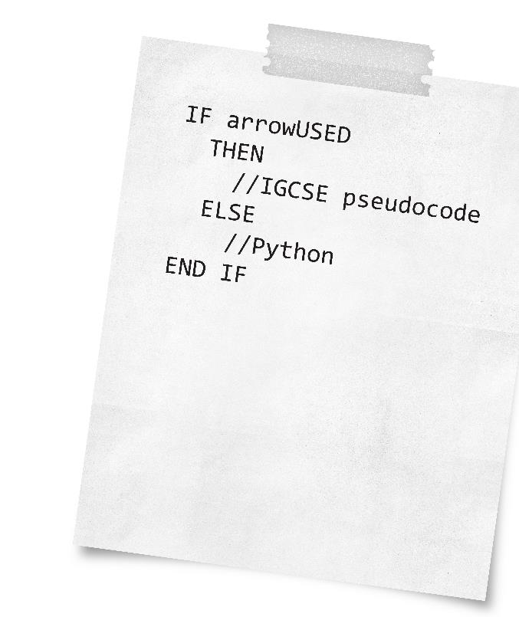

IGCSE pseudo-code
Throughout these lessons, computer code will be written using IGCSE pseudo-code
Sometimes the syntax may be different or not possible in the programming language you are studying
Sometimes examples will demonstrate a concept in a real language – this will be in Python unless stated otherwise

Slide 6
Using variables in a program
You have probably used variables in many different ways in programs you have already written
numberOfStudents ← numberOfStudents + 1
circleArea ← 3.142 * radius^2
WHILE NOT found…
answer ← 'Y'
OUTPUT studentName
What are the data types of each of the above variables?

Slide 7
Data types
Variables will typically be one of the following types:
Integer, Boolean, real, char or string
For the variables given, the data types would be:
numberOfStudents Integer
circleArea Real
found Boolean
answer Char
studentName String
The data type used will determine the amount of memory that needs to be allocated for the variable

Slide 8
Definitions of data types
Data type | Type of data | Typical amount of memory
integer | Whole number such as 156, 0 -54 | 2 bytes
real | Number with a fractional part such as 1.5276, -68.4, 20.0 | 4 bytes
char | A single ASCII character such as A, b, 3, ! or space | 1 byte
string | Zero or more characters – these are put inside quote marks – e.g. "Thank you" | 1 byte per character in the string
Boolean | Can only take the values True or False | Theoretically just one bit, but in high level languages often one byte

Slide 9
Declaring variables
Before using variables they should be declared
Declaring a variable gets it ready for use in the program
The data type is given to the variable – the programming language (compiler) can check that it is being used correctly
Examples of declaring and using variables
DECLARE sidesInShape : INTEGER DECLARE name : STRING sidesInShape ← 4
Name ← "Jody"

Slide 10
Constants
As well as variables, you can define constants in a program
CONSTANT Pi ← 3.14157926535
CONSTANT VAT ← 0.2
CONSTANT MaxPlayers ← 6
Constants are often shown in uppercase
Words are separated with an underscore, e.g. MIN_AGE
This is known as snake case
Why declare a constant instead of a variable?
Can a constant ever change its value?

Slide 11
Constants
Why declare a constant instead of a variable?
This prevents the value from being changed accidentally by a part of code
It shows a programmer that the value should stay the same throughout the program
Can a constant ever change its value?
A constant cannot be changed when the program is running
A constant can be changed by a programmer before the program is compiled or translated

Slide 12
Input and output statements
Most programs accept data from the user, process it in some way, and output a result
OUTPUT "How many hours a night do you sleep?"
INPUT hoursPerNight
hoursPerWeek ← hoursPerNight * 7
OUTPUT hoursPerWeek

Slide 13
INPUT statement
In many high-level programming languages such as Python, an input statement can have a prompt for the user:
firstName = input("What is your name? ")
This statement first displays the message “What is your name?” and then waits for the user to enter some text and press Enter
The response is then assigned to the variable firstName

Slide 14
Arithmetic operators
The operators +, -, * and / are used for addition, subtraction, multiplication and division
^ is used for an exponent (power of)
The operator DIV is used for integer division, also known as quotient
MOD (modulus) is used to find the remainder when dividing one integer by another
What is the result of the following operations?
weeks ← 31 DIV 7
daysLeft ← 31 MOD 7

Slide 15
MOD and DIV
weeks ← 31 DIV 7
The variable weeks is assigned the value 4
This is because 7 goes into 31 four times (remainder 3)
daysLeft ← 31 MOD 7
The variable daysLeft is assigned the value 3
This is because the remainder after the division is 3

Slide 16
Orders of precedence
Remember BIDMAS
Brackets
Indices
Division
Multiplication
Addition
Subtraction
Calculate: x ← (5 – 2) + (16 – 6 / 2)
y ← 7 * 3 + 10 / 2
Are brackets needed in the first expression?

Slide 17
Worksheet 1
Now complete Task 1 on Worksheet 1

Slide 18
Strings and numbers
Strings and numbers used in calculations are represented differently in binary
The string "17" is represented in binary as
0011000100110111
The integer 17 is held as in binary as
00010001

Slide 19
Inputting numeric variables
Inputs from the user are strings
Therefore if you are inputting an integer or real number, you have to convert it before it can be used in a calculation
This doesn’t matter when writing pseudocode for IGCSE, but it is important when writing in a real language such as Python
OUTPUT "Please enter number of tickets required: " INPUT tickets
In Python:
tickets = int(input("Please enter number of tickets required: "))
This converts the string input into an integer

Slide 20
Concatenating strings
Concatenating means joining together
The + concatenate operator is used to join together strings
firstname ← "Rose"
surname ← "Chan"
fullname ← firstname + " " + surname
OUTPUT fullname
What will be output?
What will be output by the program?
x ← "6" + "3"
OUTPUT x

Slide 21
Concatenating strings
firstname ← "Rose"
surname ← "Chan"
fullname ← firstname + " " + surname
OUTPUT fullname
What will be output? "Rose Chan"
What will be output by the program
x ← "6" + "3"
OUTPUT x
"63"

Slide 22
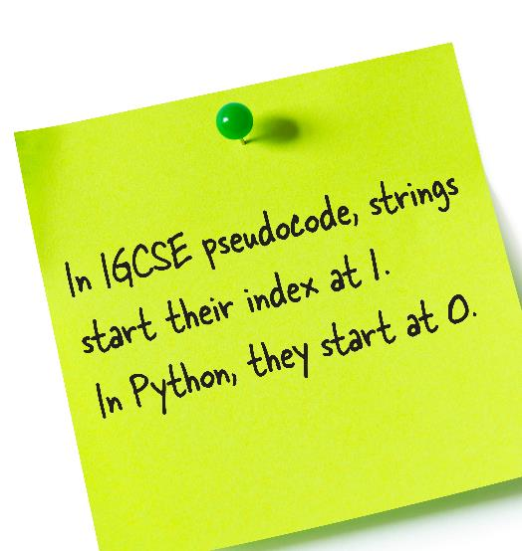
String handling functions
What will be the values of a, b and c below?
zooName ← "London Zoo"
a ← LEN(zooName) b ← SUBSTRING(zooName,2,3) c ← LCASE(zooName) d ← UCASE(zooName)
Function | Example | Result
LENGTH(str) | word ← "Algorithm" OUTPUT LENGTH(word) | 9
SUBSTRING(str, start, length) | OUTPUT(3,6,word) | "orit"
LCASE(str) | LCASE(word) | algorithm
UCASE(str) | UCASE(word) | ALGORITHM

Slide 23
String handling functions
What will be the values of a, b and c below?
zooName ← "London Zoo"
a ← LEN(zooName) 10 b ← SUBSTRING(zooName,2,3) ond c ← LCASE(zooName) london zoo d ← UCASE(zooName) LONDON ZOO
Function | Example | Result
LENGTH(str) | word ← "Algorithm" OUTPUT LENGTH(word) | 9
SUBSTRING(str, start, length) | OUTPUT(3,6,word) | "orit"
LCASE(str) | LCASE(word) | algorithm
UCASE(str) | UCASE(word) | ALGORITHM

Slide 24
Uppercase and lowercase
In Python, a string can be converted to uppercase or lowercase letters as follows:
phrase1 = "Good morning" phrase2 = "HAPPY BIRTHDAY" print(phrase1.upper()) #"GOOD MORNING" print(phrase2.lower()) #"happy birthday"
What is the output of the following program?
a ← "The quality of mercy is not strained." b ← LENGTH(a) – 30 c ← SUBSTRING(a,1,b) d ← SUBSTRING(c,1,LEN(c)-1) OUTPUT d

Slide 25
String handling
What is the output of the following program?
a ← "The quality of mercy is not strained." b ← LENGTH(a) – 30 b ← 37 - 30 b ← 7 c ← SUBSTRING(a,1,b) c ← SUBSTRING(0,7,a) c ← "The qual" d ← SUBSTRING(c,1,LEN(c)-1) d ← SUBSTRING(0,6,c) d ← "The qua" OUTPUT d "The qua"

Slide 26
Using comments
You should use comments in your programs:
to describe the purpose of the program
to state the author of the program
to explain what the code does
Pseudo-code comments start with a // symbol
In Python, comments start with #
In Java and C#, comments start with //
In VB, comments start with '
Comments are ignored when your program is translated to machine code and executed

Slide 27
Worksheet 1
Now complete Task 2 and Task 3 on Worksheet 1

Slide 28
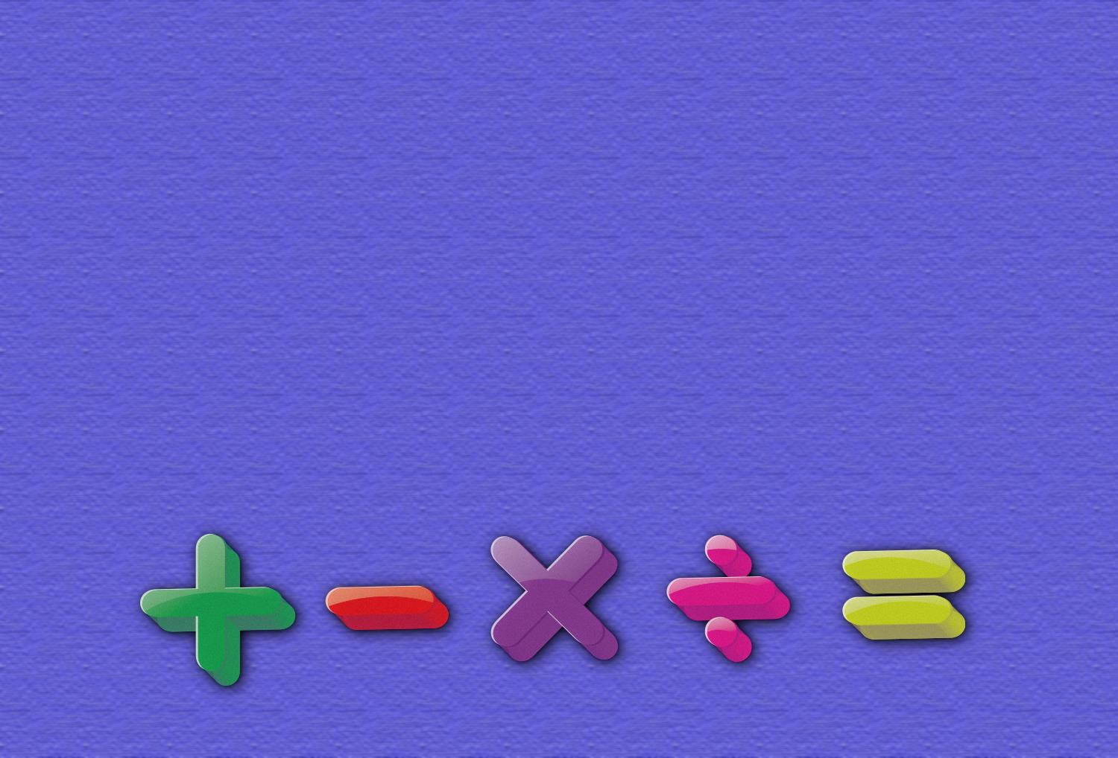

Plenary
In pairs give:
5 different data types
4 arithmetic operators
3 functions used for string operations
2 arithmetic operators used for integer division and remainder
1 concatenate operator

Slide 29
Plenary
5 different data types
Integer, real / float, char / character, string, Boolean
4 arithmetic operators +, -, *, /, ^
3 functions used for string operations
LENGTH(string), LCASE(string), UCASE(string), SUBSTRING(string, start, length)
2 arithmetic operators used for integer division and remainder
DIV (integer division), MOD (remainder)
1 concatenate operator +

